Slide 1
CS310 Operating Systems Lecture 26 Scheduling – Multilevel Feedback Queue, Lottery Scheduling
Ravi Mittal
IIT Goa

Slide 2
Acknowledgements !
Contents of this class presentation has been taken from various sources. Thanks are due to the original content creators:
CS162, Operating System and Systems Programming, University of California, Berkeley
Book: Operating System: Three Easy Pieces

Slide 3
Reading
CS162, Operating System and Systems Programming, University of California, Berkeley
Book: Operating System: Three Easy Pieces

Slide 4
Previous lectures ..

Slide 5
First-Come, First-Served (FCFS) Scheduling
First-Come, First-Served (FCFS)
Also First In First Out (FIFO) or Run until done
In early systems, FCFS meant one program scheduled until done (including I/O)
Now, means keep CPU until thread blocks
Simple Algorithm, Easy to implement (+)
FCFS Scheme: Potentially bad for short jobs!
Depends on submit order
If you are first in line at supermarket with milk, you don’t care who is behind you, on the other hand…
Convoy effect: short process stuck behind long process (-)
Ref: CS162 © UCB Fall 2020

Slide 6
Shortest Job First (SJF)
Non-preemptive
Run whatever job has least amount of computation to do
Provably optimal
Need to know run times in advance
Kubiatowicz CS162 © UCB Fall 2020

Slide 7
Shortest Remaining Time First (SRTF)
Preemptive version of SJF
If job arrives and has a shorter time to completion than the remaining time on the current job, immediately preempt CPU
Sometimes called Shortest Remaining Time to Completion First (SRTCF)
Both SJF and SRTF:
These can be applied to whole program or current CPU burst
Idea is to get short jobs out of the system
Big effect on short jobs, only small effect on long ones
Result is better average response time
Kubiatowicz CS162 © UCB Fall 2020

Slide 8
Round Robin (RR) Scheduling
Uses Preemption!
Each process gets a small unit of CPU time (time quantum), usually 10-100 milliseconds
After quantum expires, the process is preempted and added to the end of the ready queue
n processes in ready queue and time quantum is q
Each process gets 1/n of the CPU time
In chunks of at most q time units
No process waits more than (n-1)q time units
Ref: CS162 © UCB Fall 2020

Slide 9
Multilevel Queue Scheduling – Strict Priority
Priority 3
Job 1
Job 2
Job 3
Priority 2
Job 4
Priority 1
Priority 0
Job 5
Job 6
Job 7
Execution Plan
Always execute highest-priority runnable jobs to completion
Each queue can be processed in RR with some time-quantum
A priority is assigned statically to each process, and a process remains in the same queue for the duration of the run time
Problems
Starvation
Lower priority jobs don’t get to run because higher priority jobs
Deadlock: Priority Inversion
Happens when low priority task holds a lock needed by high-priority task
Ref: CS162 © UCB Fall 2020

Slide 10
Today we will study
Multilevel Feedback Queue
Changing landscape of scheduling
Proportionate share scheduling
Lottery Scheduling

Slide 11
Multilevel Feedback Queue

Slide 12
Dealing with Starvation
Strict priority scheduling may lead to situation where low priority processes may starve
One solution is
Don’t assign priorities that are static – fixed for lifetime of the process
But, change priority of a process – dynamically
Scheduler can decrease the priority of the current running process
Penalizing it for taking too much CPU time
Alternatively, Scheduler keeps track of low priority processes that are not getting a chance to run
Increase their priority
Ref: CS162 © UCB Fall 2020

Slide 13
Multilevel Feedback Queue
Multilevel queues with no strict priority
Scheduler is allowed to change priority of a process
Dynamic priority
A multilevel feedback queue uses two basic rules:
A new process gets placed in the highest priority queue
If a process does not finish its quantum (due to I/O)
Then it will stay at the same priority level (round robin)
Else it moves to the next lower priority level
A process with long CPU bursts will use its entire time slice
Get preempted and get placed in a lower-priority queue
A highly interactive process will not use up its quantum and will remain at a high priority level
Ref: CS162 © UCB Fall 2020

Slide 14
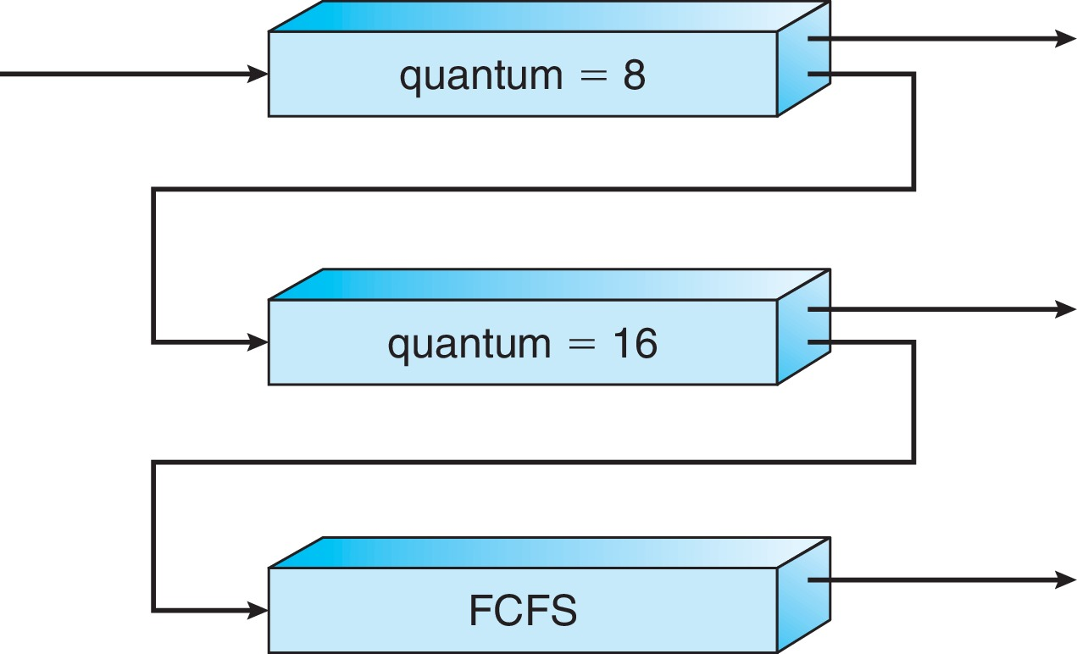
Example of Multilevel Feedback Queue
Three queues:
Q₀ – RR with time quantum 8 milliseconds
Q₁ – RR time quantum 16 milliseconds
Q₂ – FCFS
Scheduling
A new process enters queue Q₀ which is served in RR
When it gains CPU, the process receives 8 milliseconds
If it does not finish in 8 milliseconds, the process is moved to queue Q₁
At Q₁ job is again served in RR and receives 16 additional milliseconds
If it still does not complete, it is preempted and moved to queue Q₂
Starvation problem still exists
When new processes are frequently created or there are too many interactive processes → CPU bound processes are never scheduled
Ref: CS162 © UCB Fall 2020

Slide 15
Cause for Starvation: Priorities?
The policies we’ve studied so far:
Always prefer to give the CPU to a prioritized job
Non-prioritized jobs may never get to run
But priorities were a means, not an end
Our end goal was to serve a mix of CPU-bound, I/O bound, and Interactive jobs effectively on common hardware
Give the I/O bound ones enough CPU to issue their next file operation and wait (on those slow discs)
Give the interactive ones enough CPU to respond to an input and wait (on those slow humans)
Ref: CS162 © UCB Fall 2020

Slide 16
Changing landscape ..

Slide 17
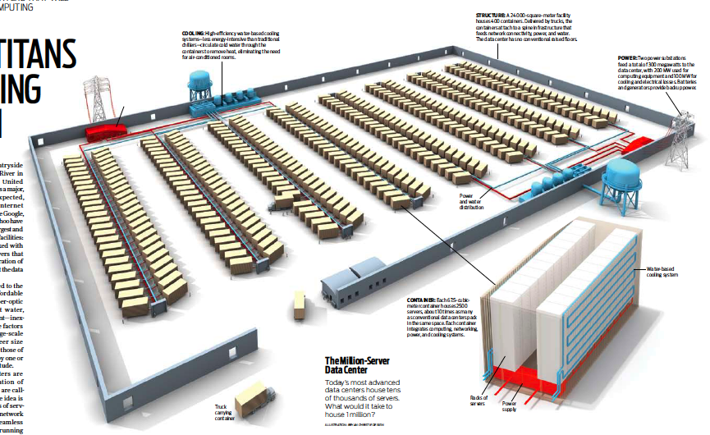
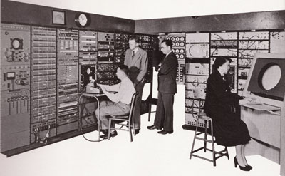
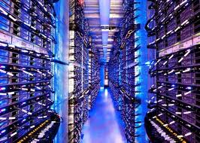
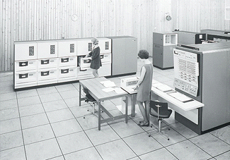
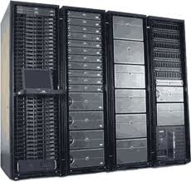
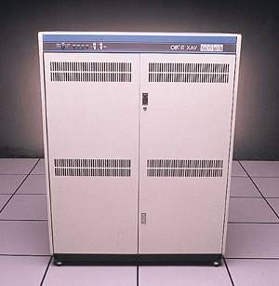
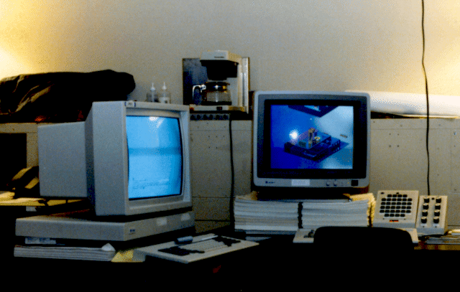

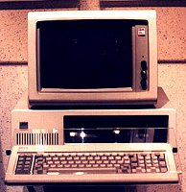





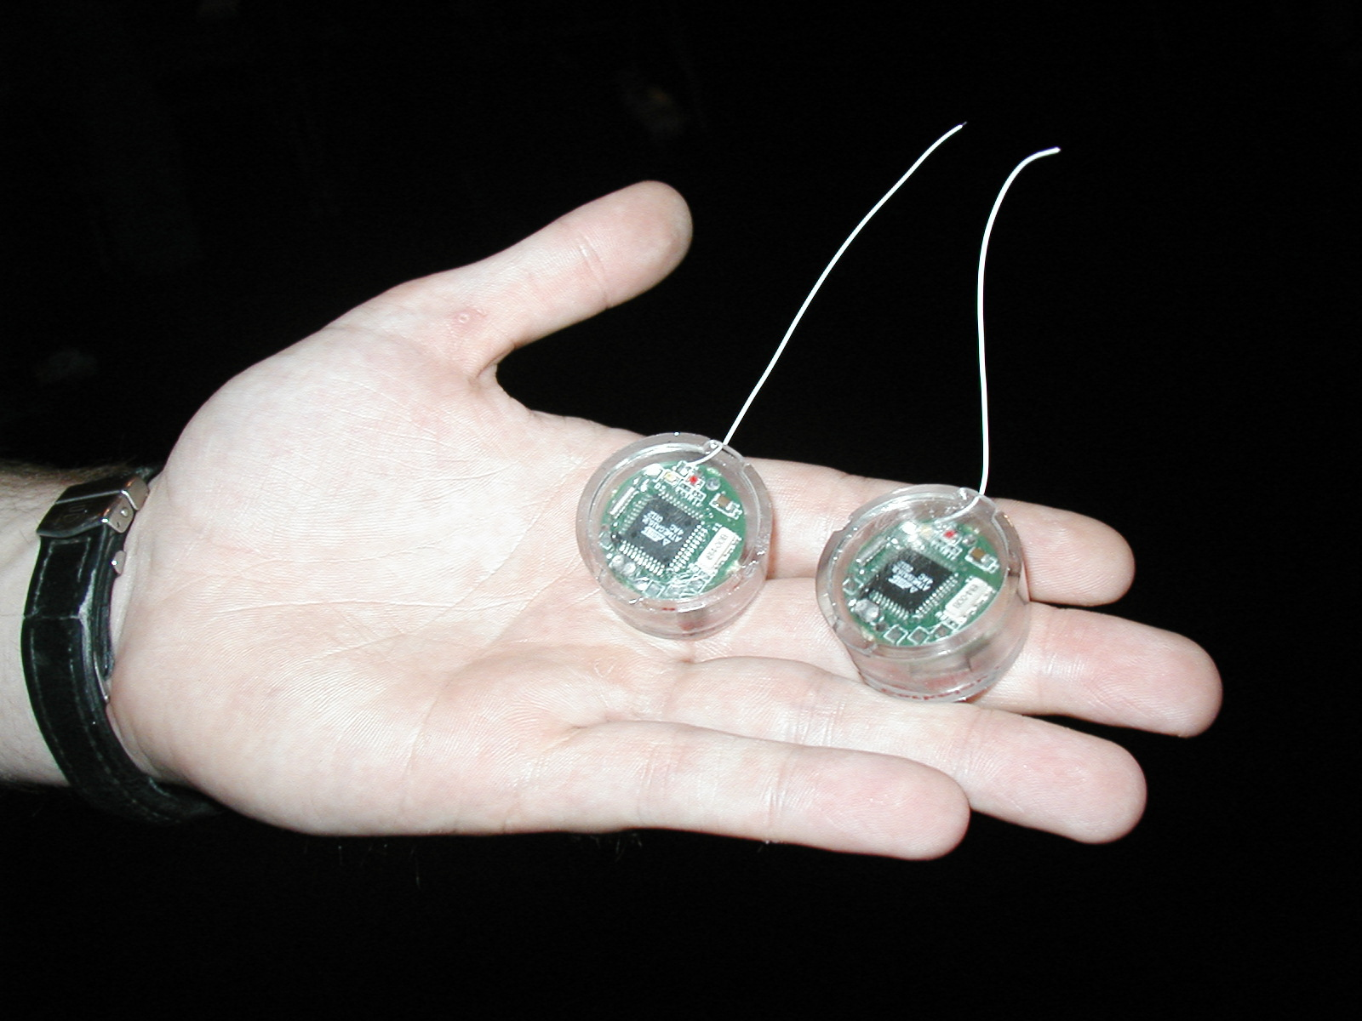
Changing Landscape…
Computers
Per Person
Number crunching, Data Storage, Massive Inet Services,
ML, …
1:10⁶
Mainframe
Bell’s Law: New computer class every 10 years
Mini
1:10³
Workstation
Productivity,
Interactive
PC
1:1
Laptop
PDA
Cell
Streaming from/to the physical world
10³:1
years
The Internet of Things!
Ref: CS162 © UCB Fall 2020

Slide 18
Changing Landscape of Scheduling
Priority-based scheduling rooted in “time-sharing”
Allocating precious, limited resources across a diverse workload
CPU bound, vs interactive, vs I/O bound
80’s brought about personal computers, workstations, and servers on networks
Different machines of different types for different purposes
Shift to fairness and avoiding extremes (starvation)
90’s emergence of the web, rise of internet-based services, the data-center-is-the-computer
Server consolidation, massive clustered services, huge flash crowds
It’s about predictability, 95th percentile performance guarantees
Ref: CS162 © UCB Fall 2020

Slide 19
Does prioritizing some jobs necessarily starve those that aren’t prioritized?

Slide 20
Key Idea: Proportional-Share Scheduling
The policies we’ve studied so far:
Always prefer to give the CPU to a prioritized job
Non-prioritized jobs may never get to run
Instead, we can share the CPU proportionally
Give each job a share of the CPU according to its priority
Low-priority jobs get to run less often
But all jobs can at least make progress (no starvation)
Ref: CS162 © UCB Fall 2020

Slide 21
Lottery Scheduling (Fair Share Scheduling)

Slide 22
Lottery Scheduling
Q _{i}
Q _{i+1}
time
Given a set of jobs (the mix), provide each with a share of a resource
e.g., 50% of the CPU for Job A, 30% for Job B, and 20% for Job C
Idea: Give out tickets according to the proportion each should receive
Every quantum: draw one at random, schedule that job (thread) to run
Ref: CS162 © UCB Fall 2020

Slide 23
Lottery Scheduling
Proportional share scheduling
Give each job some number of lottery tickets
On each time slice, randomly pick a winning ticket
On average, CPU time is proportional to number of tickets given to each job
How to assign tickets? Users can define policy
To approximate SRTF, short running jobs get more, long running jobs get fewer
To avoid starvation, every job gets at least one ticket (everyone makes progress)
Advantage over strict priority scheduling: behaves gracefully as load changes
Adding or deleting a job affects all jobs proportionally, independent of how many tickets each job possesses
Use Randomness
Requires a good random number generator
Ref: CS162 © UCB Fall 2020

Slide 24
Lottery Scheduling Example (Cont.)
Lottery Scheduling Example
Assume short jobs get 10 tickets, long jobs get 1 ticket (total 11 tickets)
How to do ticket distribution when processes come and go and get blocked?
Not a useful algorithm for general-purpose scheduling
Useful for environments with long-running processes that may need to be allocated shares of CPUs
Example: running multiple virtual machines on a server
# short jobs/ # long jobs | % of CPU each short jobs gets | % of CPU each long jobs gets
1/1 | 91% | 9%
0/2 | N/A | 50%
2/0 | 50% | N/A
10/1 | 9.9% | 0.99%
1/10 | 50% | 5%
Ref: CS162 © UCB Fall 2020

Slide 25
Lottery Fairness
Two jobs competing against each other
Both have the same number of tickets say 100
Both have the same run time R
Ideally each job must finish roughly at the same time
Due to randomness, sometimes one job finishes before the other
Fairness Metric: F
Time the first job competes / time the second job completes
Ex: R = 10; First job completes at time 10 and second job completes at time 20; F= 10/20 = 0.5
When both finish at nearly the same time, F = 1
OSTEP book

Slide 26
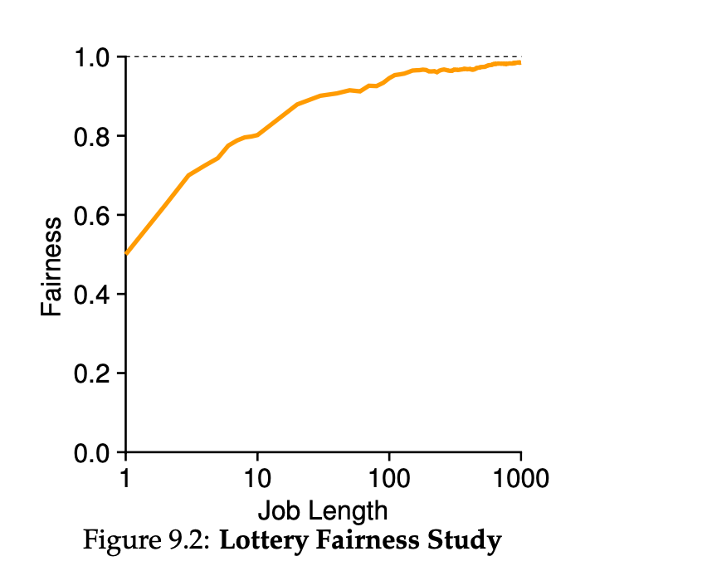
A simulation
R varies from 1 to 1000 over 30 trials
OSTEP book

Slide 27
How to Assign Tickets?
How many to each user?
User knows the best
Each user is handed over a certain number of ticekts
User can allocate them to his/her jobs
Ticket Assignment problem remains open.
OSTEP book

Slide 28
Lecture Summary
Multilevel Feedback Queue
It has multiple levels of queues
It uses feedback to determine priority of each job
Based on how jobs behave over time
It is not based on concept of prior knowledge of the nature of the job … but observes the execution of a job and prioritize accordingly
We have studied the concept of proportional – share scheduling
Lottery Scheduling
Lottery scheduling uses randomness in a clever way to achieve proportional share

